Slide 1
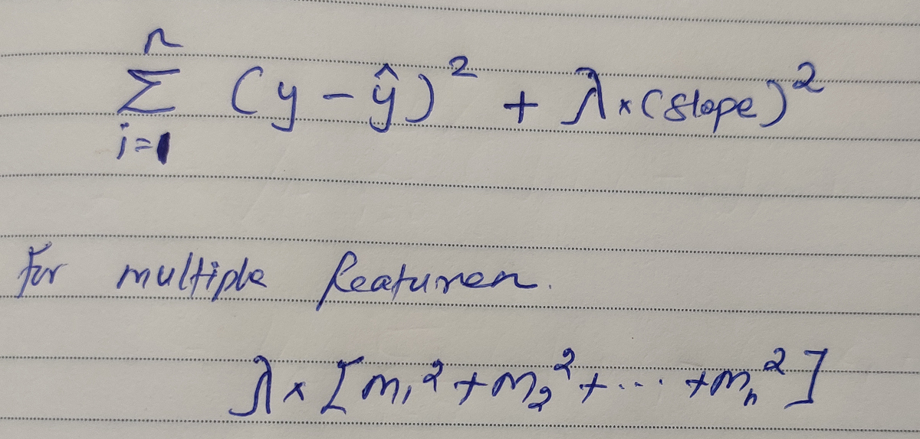
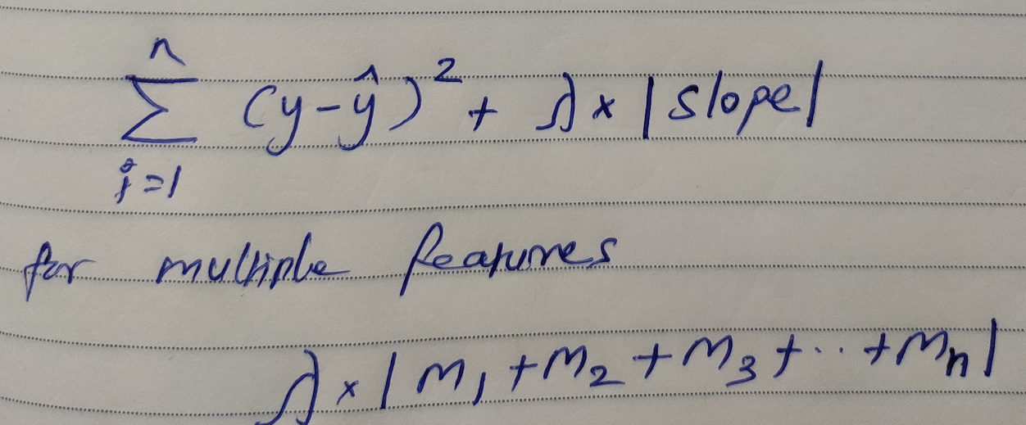
RIDGE AND LASSO REGRESSION (Multicollinearity Prevention)
Y
Regression line with High Steep
RIDGE
Regression line with Low Steep
X
High Steep | Low Steep
Overfitting | Best Fit line
Slope is High | Slope is Low
LASSO
Hyperparameter can be finalized by Grid Search
And nullify multicollinearity issues

Slide 2
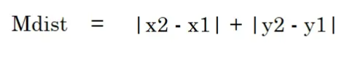
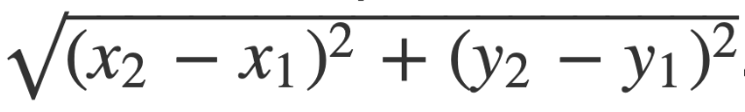
Understanding K Nearest Neighbour Algorithm
Y
X2,Y2
Manhattan Distance
X1,Y1
X
Euclidean Distance
It might make sense to calculate Manhattan distance instead of Euclidean distance for two vectors in an integer feature space.

Slide 3
Cluster 1
Step 1: Assume K value (Nearest Neighbours)
Step 2: Calculate the distance between query and nearest neighbours
Step 3: How many nearest neighbours in Cluster 1 and Cluster 2
Step 4: Based on count of nearest neighbours in clusters , assume query belongs to particular cluster
Query Point
If K = 5
Cluster 2
Key Challenges: A. Outliers ,
B. Imbalanced Data

Slide 4
How Outliers and Imbalanced Data affect KNN?
Cluster 1
Cluster 1
Outliers
Query Point
If K = 20
Query Point
If K = 5
Cluster 2
Cluster 2
Imbalanced Data results bias in output of KNN.
Outliers are not usually correlated with clusters , so output nature wrongly predict outcomes.
** In Order to Sort such issues , Conducting grid search on multiple K values do the ‘Error Rate’ analysis and find the best one

Slide 5
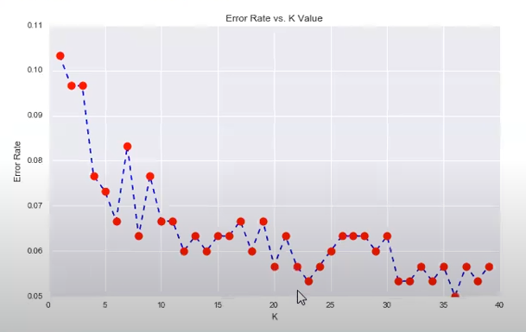
** In Order to Sort such issues , Conducting grid search on multiple K values do the ‘Error Rate’ analysis and find the best one
Here if you check, When K >23 ,
Error rate hover around 0.05 – 0.06…
So better take K as 23 and do the modelling

Slide 6
Support Vector Machines - Intuition
Marginal Distance ( D+, D- )
Positive Cluster
Low Margin Distance
Hyper Plane
Marginal plane
Negative Cluster
Support Vectors
Non - Linear Separable Points – 2D
Linear Separable Points – Multi Dimension
SVM Kernels
SVM Kernels are used here to have intuition about datapoints in multi dimension

Slide 7
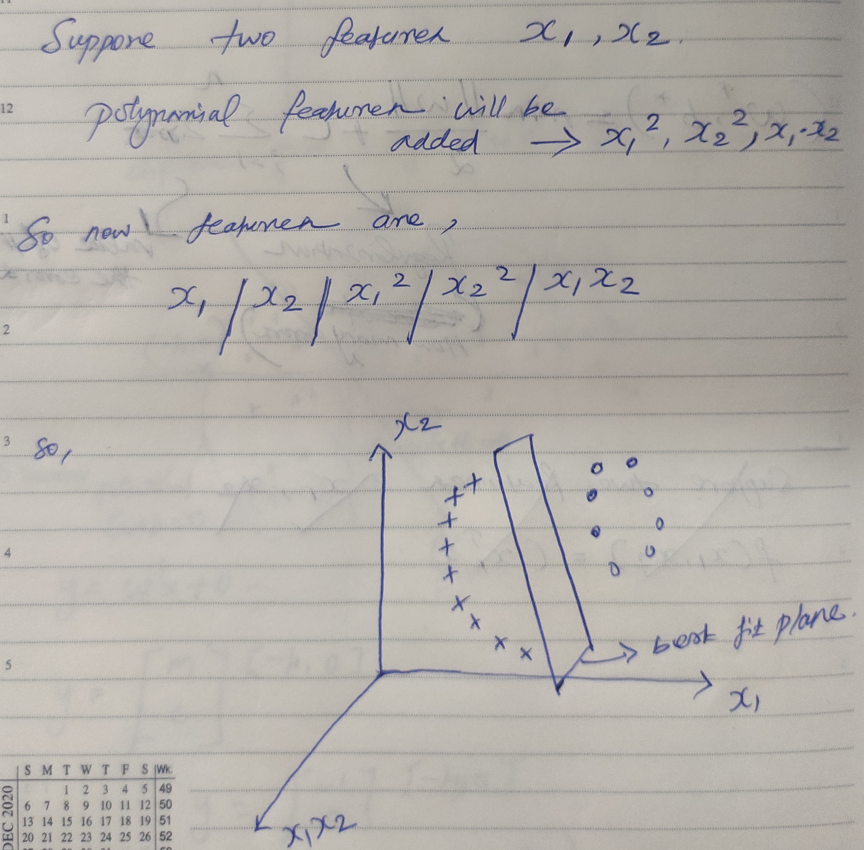
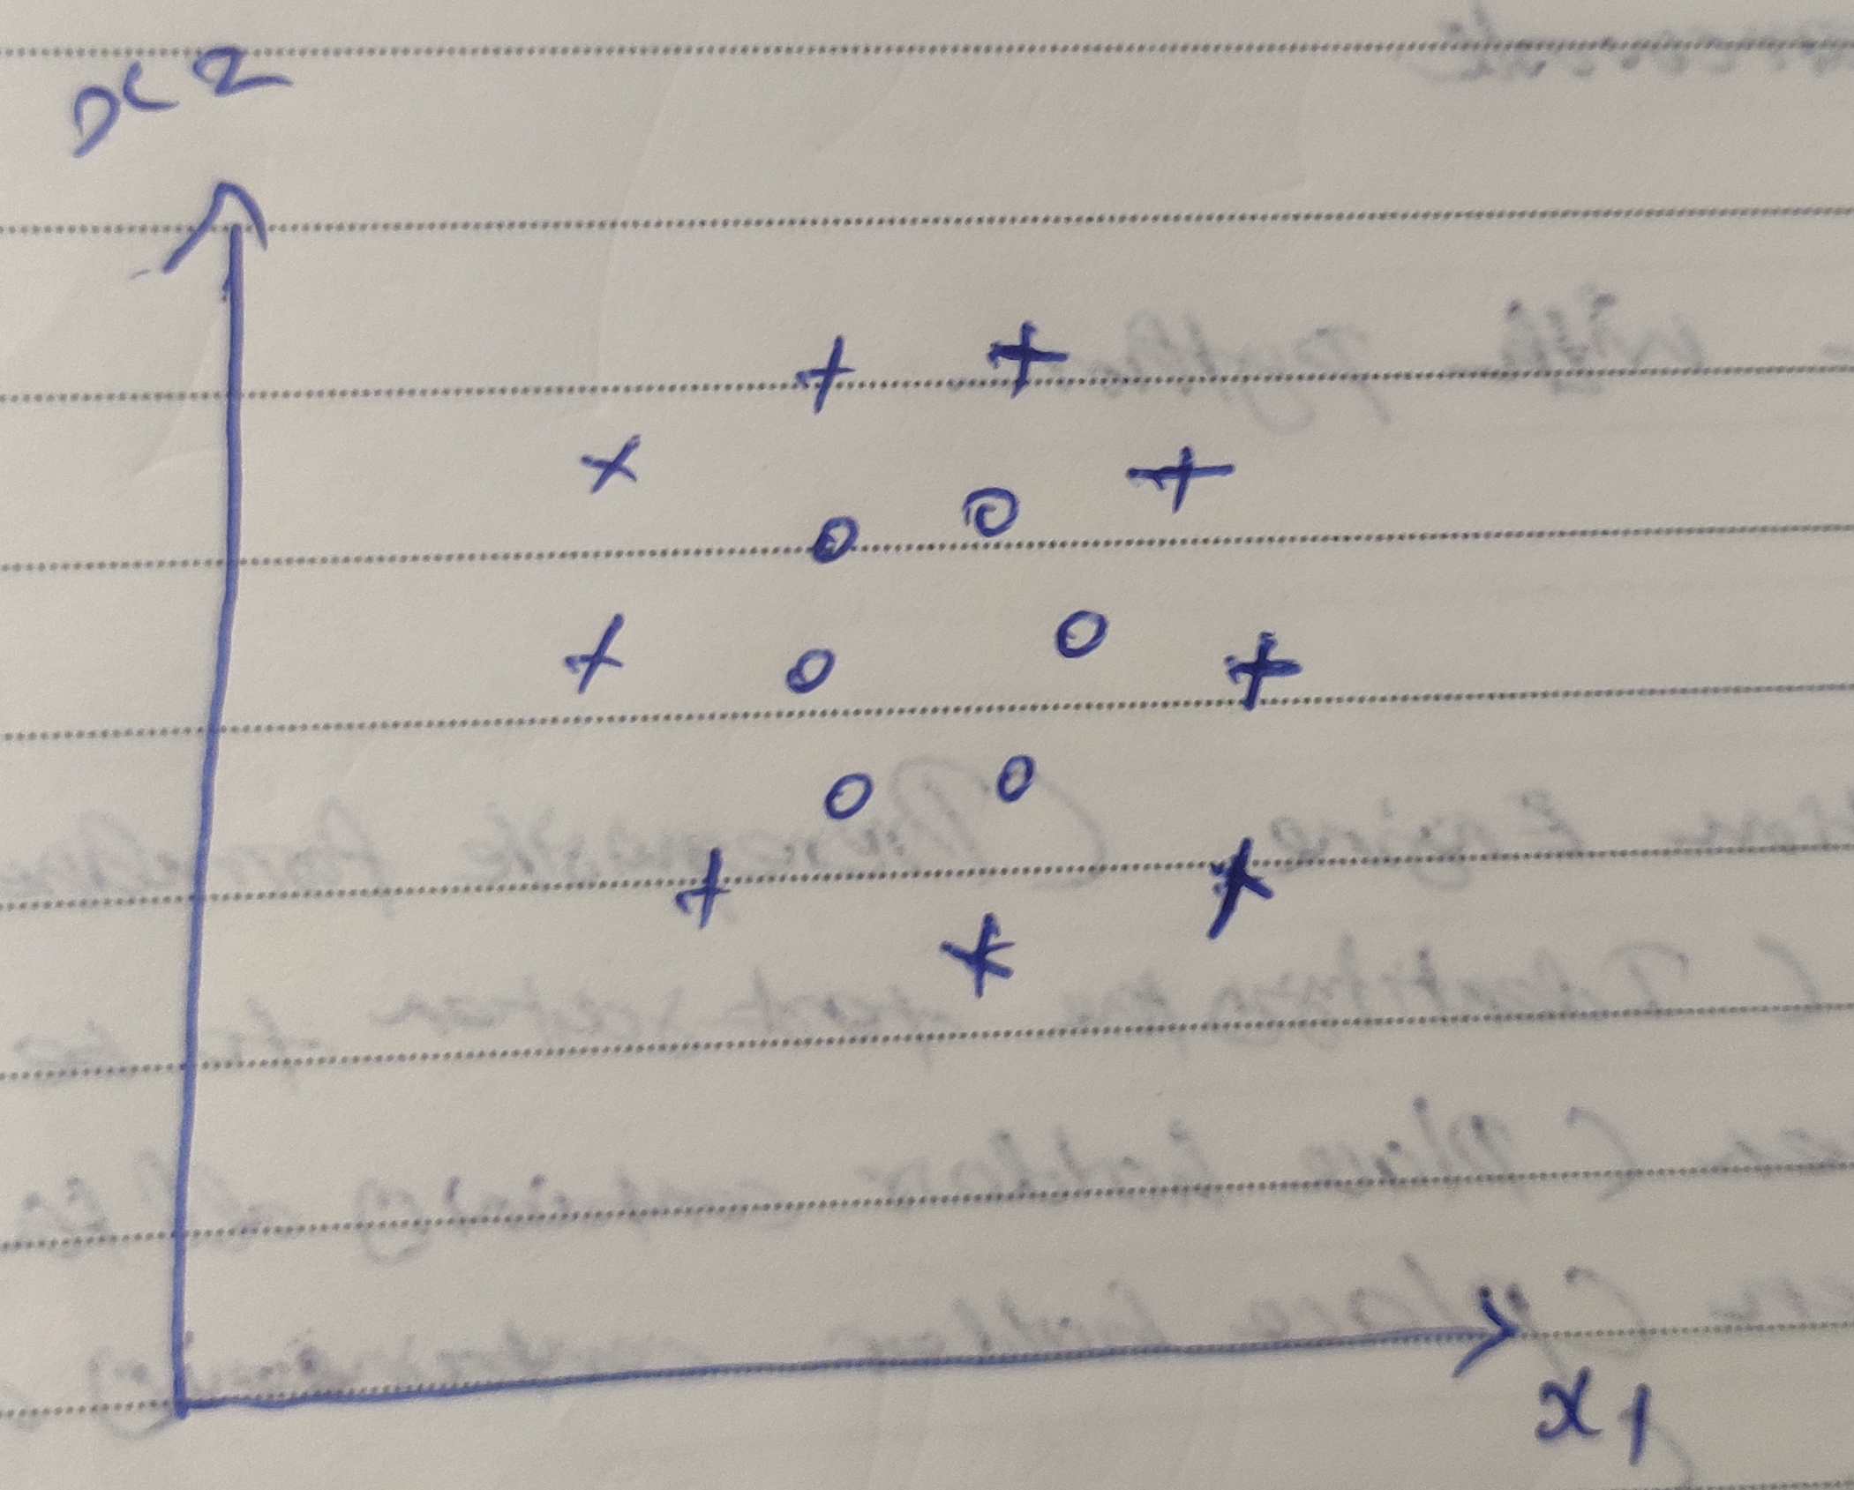
SVM Kernels: (Polynomial)
Other Kernels : ‘rbf’ , ‘Sigmoid’

Slide 8
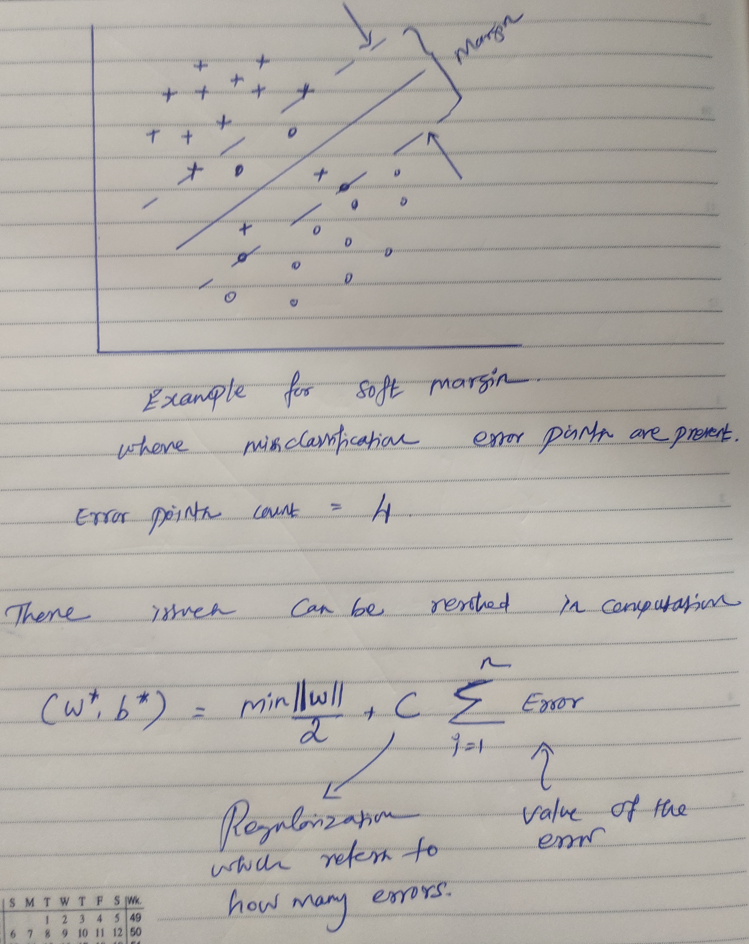
Soft Margin Intuition

